Slide 1

A World Away: Hunting for Exoplanets with AI
2025 NASA Space Apps Challenge
https://deepskydivers.us
By:
Sanjana Vishwanatha
Nagarjun TS
Notes:
Hello, I am Sanjana Motte Vishwanatha, a newly graduated software engineer with a keen interest in AI. Our team, Deepsky Divers, consists of two members: myself and Nagarjun, who specializes in Generative and Machine Learning engineering. The name Deepsky Divers reflects the ambitious challenge we've undertaken this year for NASA's 2025 Space Apps competition, titled "A World Away: Hunting for Exoplanets with AI."

Slide 2
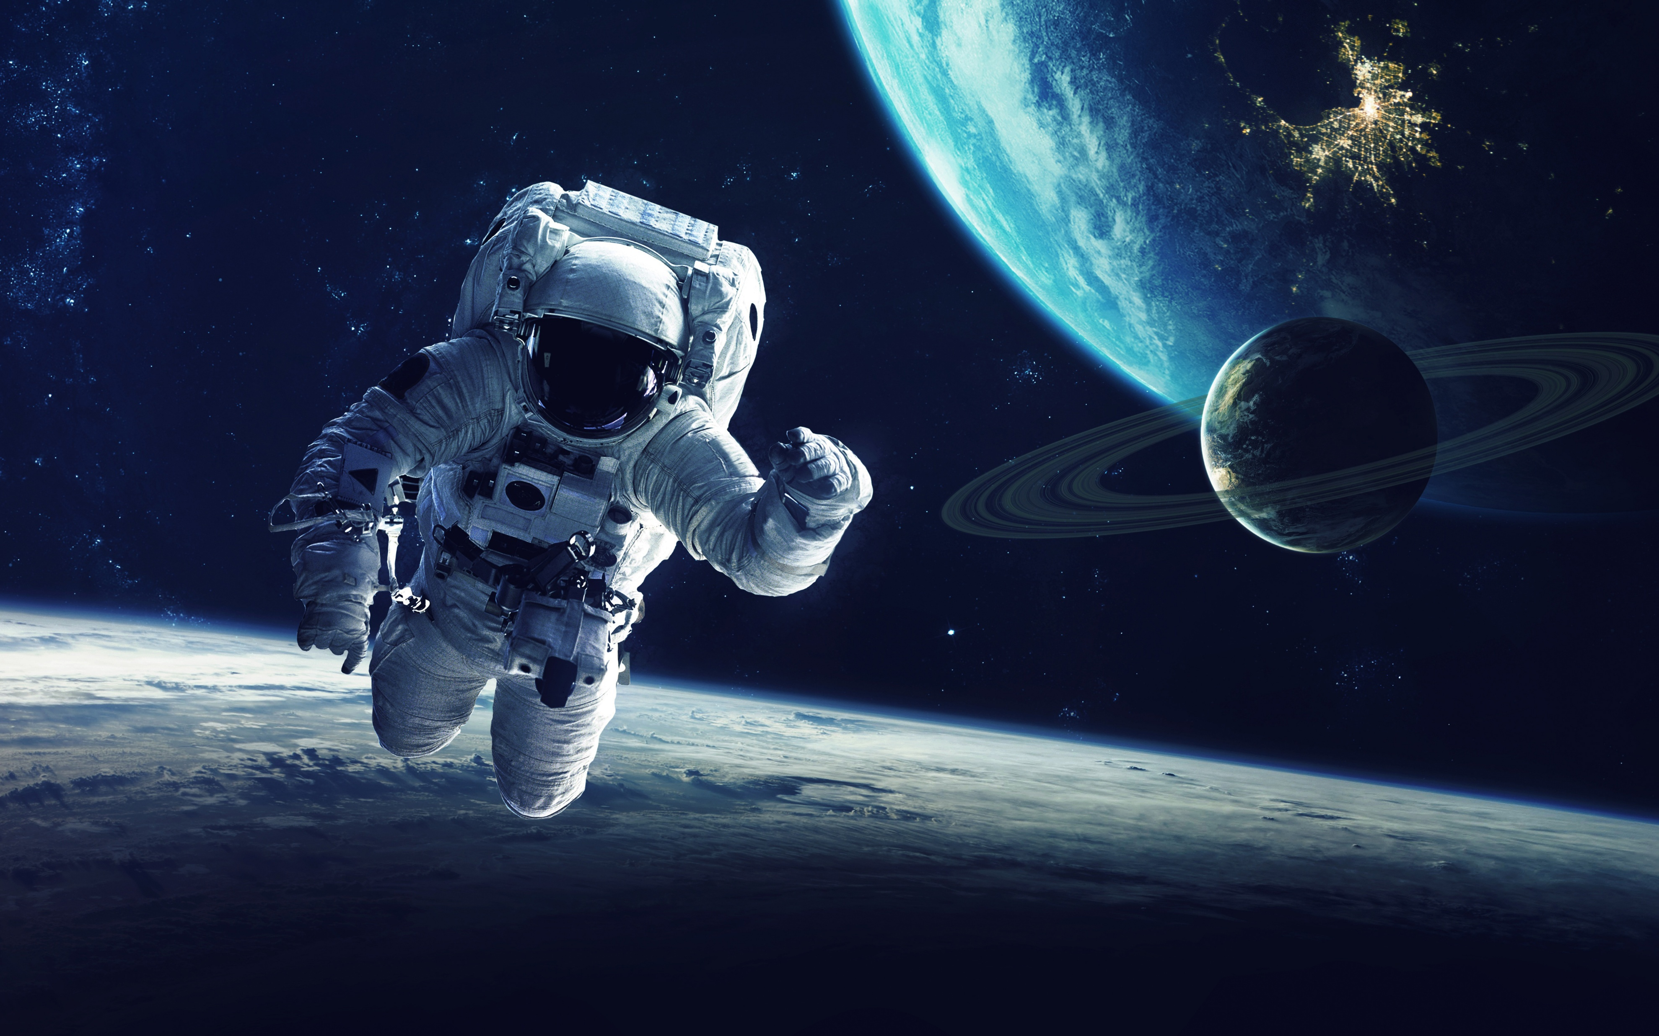
Agenda
Objective
Exoplanet Brief Explanation
Our Approach
Data Cleaning & Preprocessing
Machine Learning Model
Demo App
Challenges We Faced
References / Articles
Future Work/ Conclusion
Notes:
Objective: Outline the goals and purpose of our project.
Exoplanet Brief Explanation: Provide a concise overview of what exoplanets are and their significance.
Our Approach: Describe the methodology and strategies we employed to tackle the problem.
Data Cleaning & Preprocessing: Detail the steps taken to prepare and refine our data for analysis.
Machine Learning Model: Explain the machine learning techniques and models used in our project.
Demo App: Present a live demonstration of our application.
Challenges We Faced: Discuss the obstacles and difficulties encountered during the project.
References / Articles: Cite the key sources and literature that informed our work.
Future Work/ Conclusion: Summarize our findings and propose directions for future research and development.

Slide 3
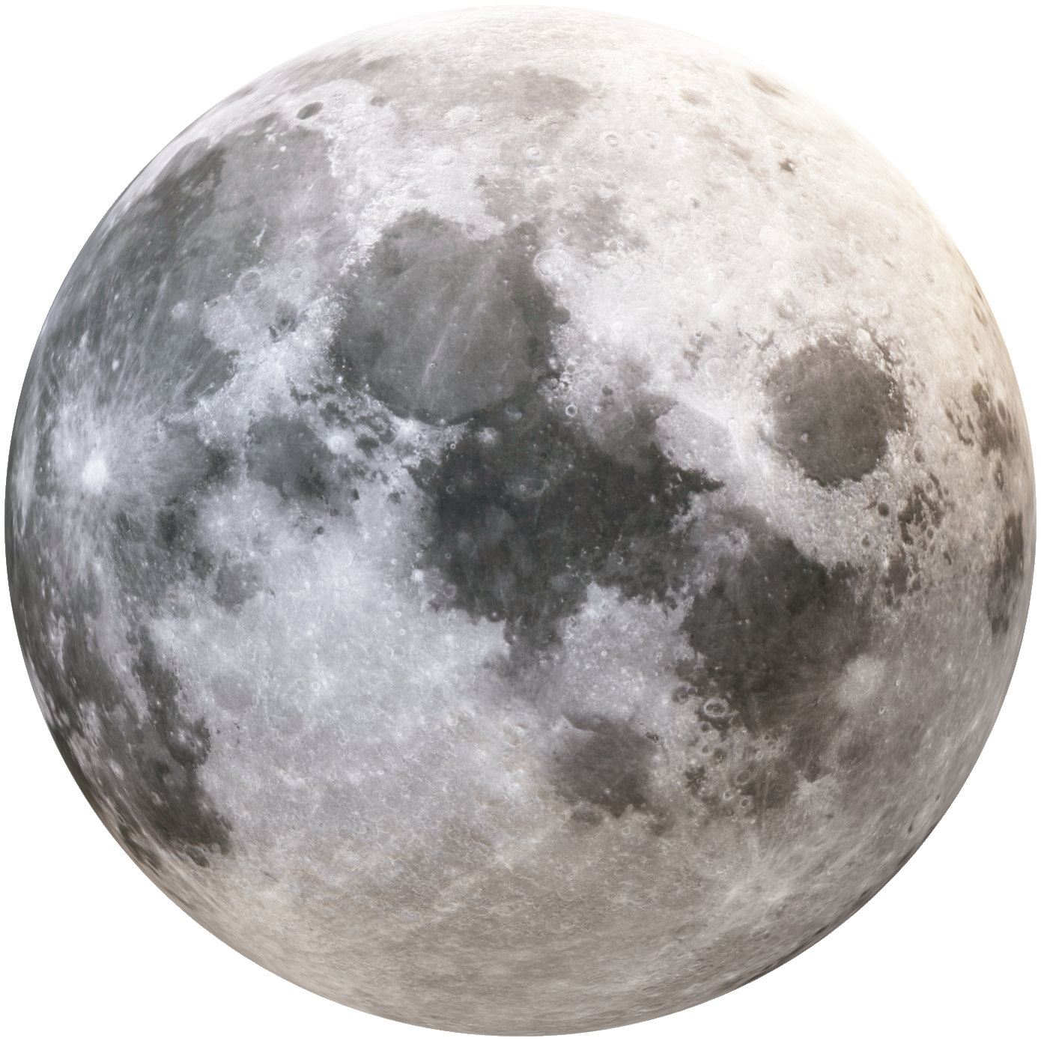
Objective
To automate the identification of exoplanets using AI and machine learning.
Build a robust pipeline from analyzing the raw data to predictions.
Provide an easy-to-use web app for scientists and enthusiasts.
Notes:
Automate Exoplanet Identification: Utilize AI and machine learning algorithms to streamline the process of detecting exoplanets.
Develop a Robust Pipeline: Create a comprehensive system that processes raw astronomical data and generates accurate predictions.
User-Friendly Web Application: Offer a web-based tool that allows scientists and space enthusiasts to easily access and interact with our findings.

Slide 4
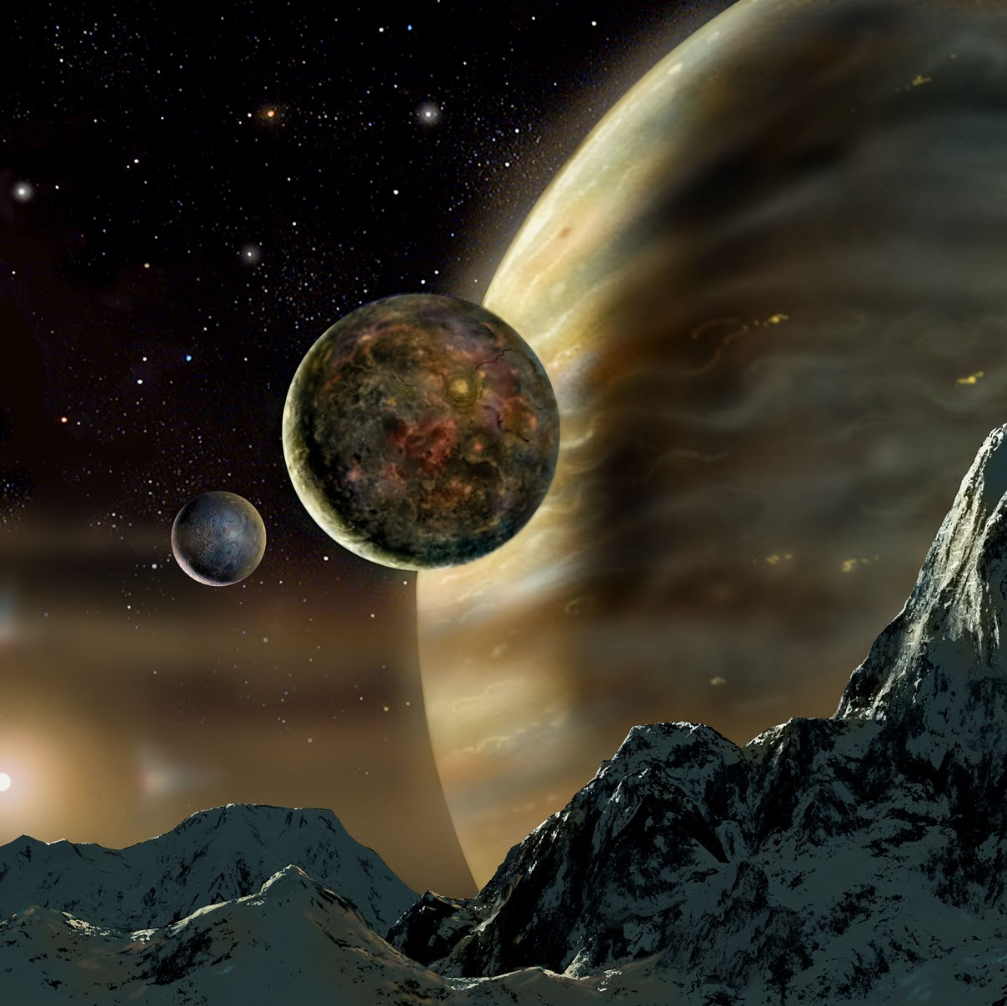
What is Exoplanet ?
An exoplanet or extrasolar planet is a planet outside of the Solar System
Objects with true masses below the limiting mass for thermonuclear fusion of deuterium that orbit stars or stellar remnants are "planets".
The minimum mass/size required for an extrasolar object to be considered a planet should be the same as that used in the Solar System.
There are many methods of detecting exoplanets. Transit photometry and Doppler spectroscopy have found the most.
Notes:
An exoplanet, also known as an extrasolar planet, is a planet that exists outside of our Solar System. These planets orbit stars or remnants of stars, and their masses are below the limit needed for thermonuclear fusion of deuterium, which means they are true planets. To classify an object as an exoplanet, it must meet the same size and mass criteria as planets in our Solar System. Scientists use various methods to detect exoplanets, with transit photometry and Doppler spectroscopy being the most successful techniques.

Slide 5
Our Approach.. !
Utilized publicly available exoplanet datasets from NASA missions (Kepler & TESS).
Brainstorming all available columns in the NASA datasets (dropped irrelevant or redundant features, e.g., unique IDs, post-prediction labels)
Evaluated several machine learning algorithms.
Chose Random Forest Classifier for its robustness, interpretability, and strong performance on Classification data.
Continuously refined feature selection and preprocessing steps based on model performance.
Validated results using accuracy, precision, and recall metrics.
Developed a user-friendly web application for both single and batch predictions.
Notes:
Our approach began by using publicly available datasets from NASA missions such as Kepler and TESS, which contain information about exoplanets. We carefully examined all the columns in these datasets, removing any irrelevant or redundant features like unique IDs and post-prediction labels. After evaluating several machine learning algorithms, we selected the Random Forest Classifier due to its robustness, interpretability, and strong performance in classification tasks. We continuously refined our feature selection and preprocessing steps to improve model performance. The accuracy, precision, and recall metrics were used to validate our results. Finally, we developed a user-friendly web application that allows users to make both single and batch predictions about exoplanets.

Slide 6
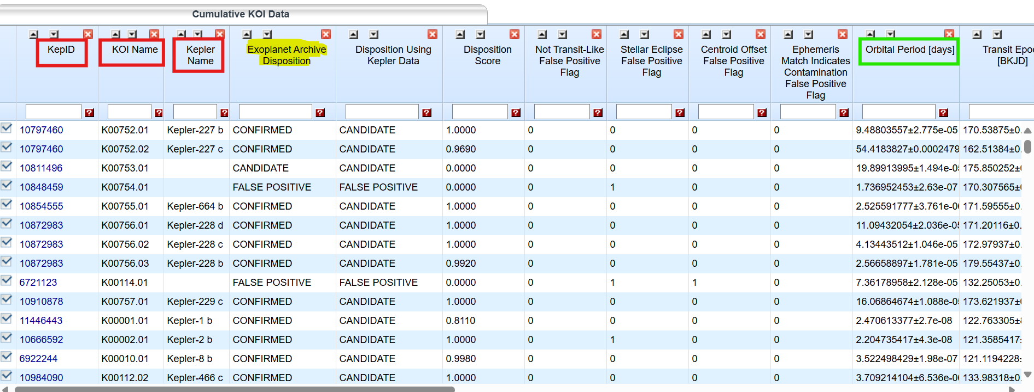

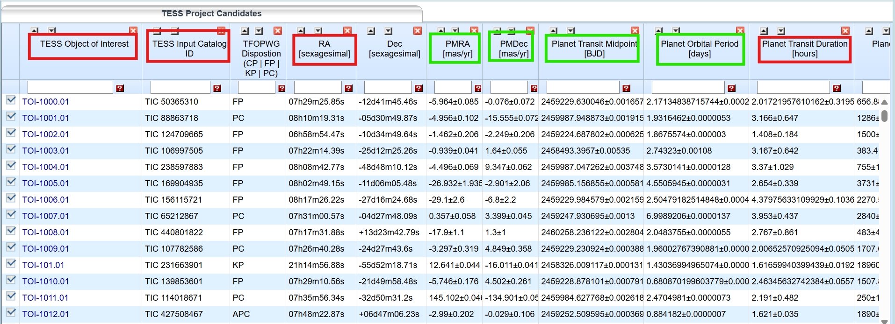

Data Cleaning & Preprocessing
Kepler Objects of Interest (KOI)
Null Handling: Replace missing values with median.
Scaling: Use RobustScaler to normalize features. (Highlighted in Green)
Categorical Encoding: Convert categorical columns to numerical codes.
Feature Selection: Drop irrelevant or redundant columns. (Highlighted in Red)
TESS Objects of Interest (TOI)
Notes:
Null Handling: In our dataset, we encountered missing values which can affect the performance of machine learning models. To handle these null values, we used a technique called imputation. Specifically, we replaced the missing values with the median of the respective columns. The median is a robust measure of central tendency that is less sensitive to outliers compared to the mean, ensuring that the imputed values are representative of the dataset.
Scaling: To ensure that all features contribute equally to the model and to improve convergence during training, we normalized the features using RobustScaler. This scaler transforms the data by removing the median and scaling according to the interquartile range (IQR). Unlike other scaling methods, RobustScaler is effective in handling outliers, making it a suitable choice for our dataset. The normalized features are highlighted in green.
Categorical Encoding: Our dataset included categorical columns, which contain non-numeric values. Machine learning algorithms require numerical input, so we converted these categorical columns into numerical codes using encoding techniques. One common method is one-hot encoding, which creates binary columns for each category. Another method is label encoding, which assigns a unique integer to each category. This conversion allows the model to process categorical data effectively.
Feature Selection: To streamline our dataset and enhance model performance, we performed feature selection. This involved dropping columns that were irrelevant or redundant, such as unique IDs and post-prediction labels, which do not contribute to the predictive power of the model. We used techniques like correlation analysis and domain knowledge to identify and remove these columns. The irrelevant or redundant columns are highlighted in red.

Slide 7
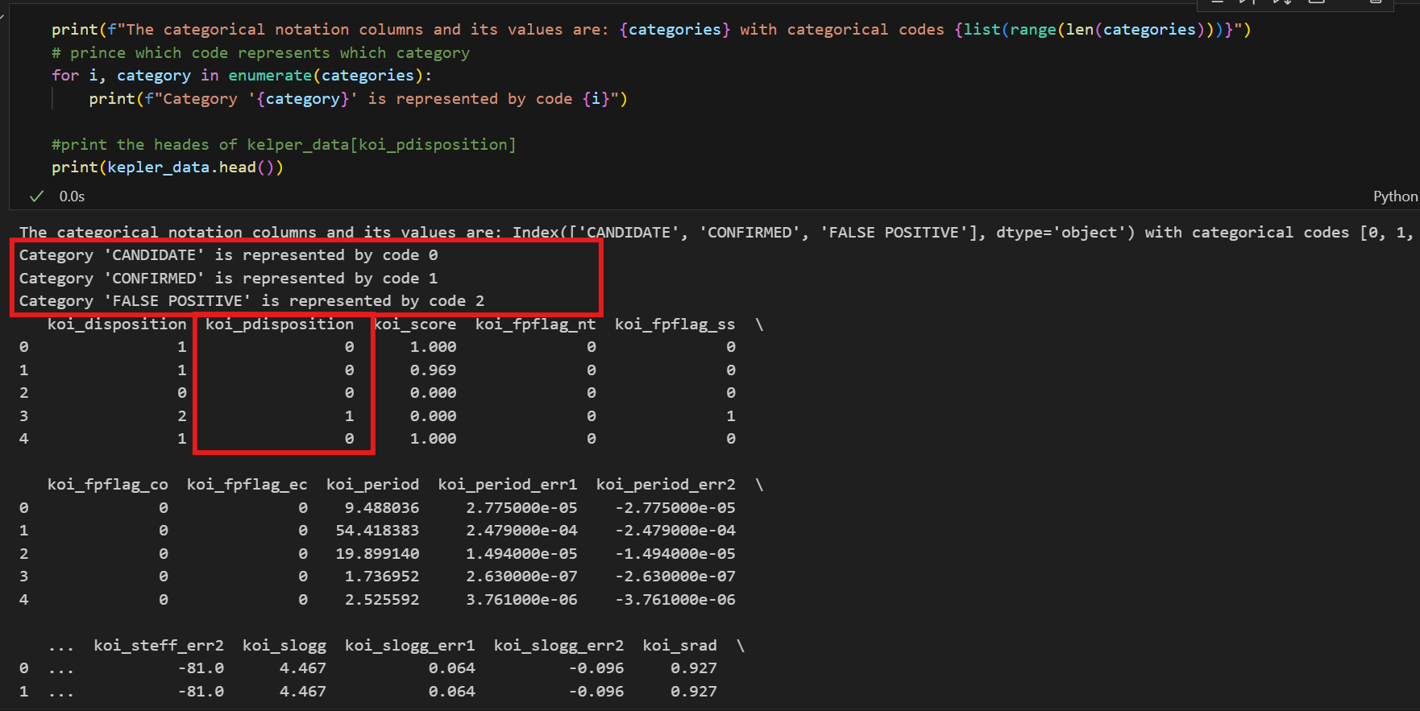
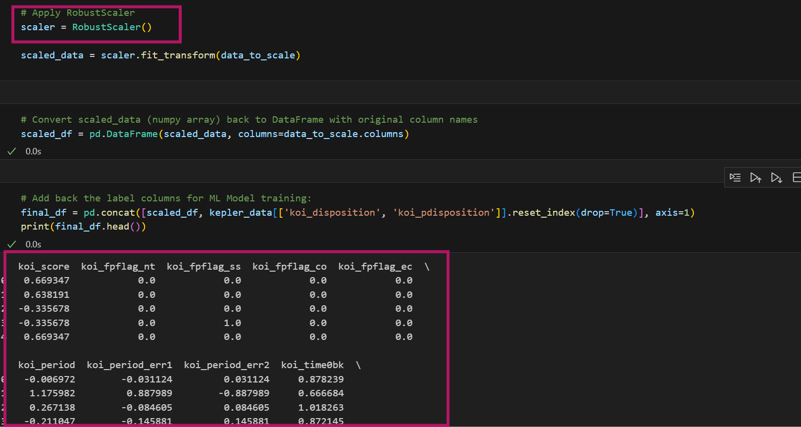
Categorical Encoding…..
'CANDIDATE’ → 0
'CONFIRMED’ → 1
'FALSE POSITIVE’ → 2
…..RobustScaler to normalize features

Slide 8
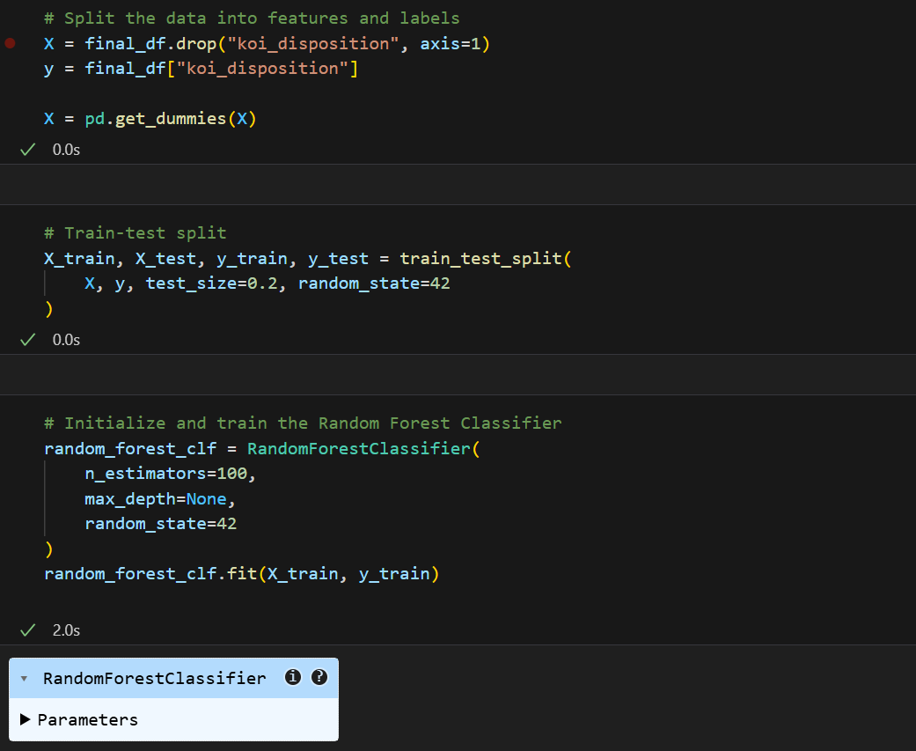
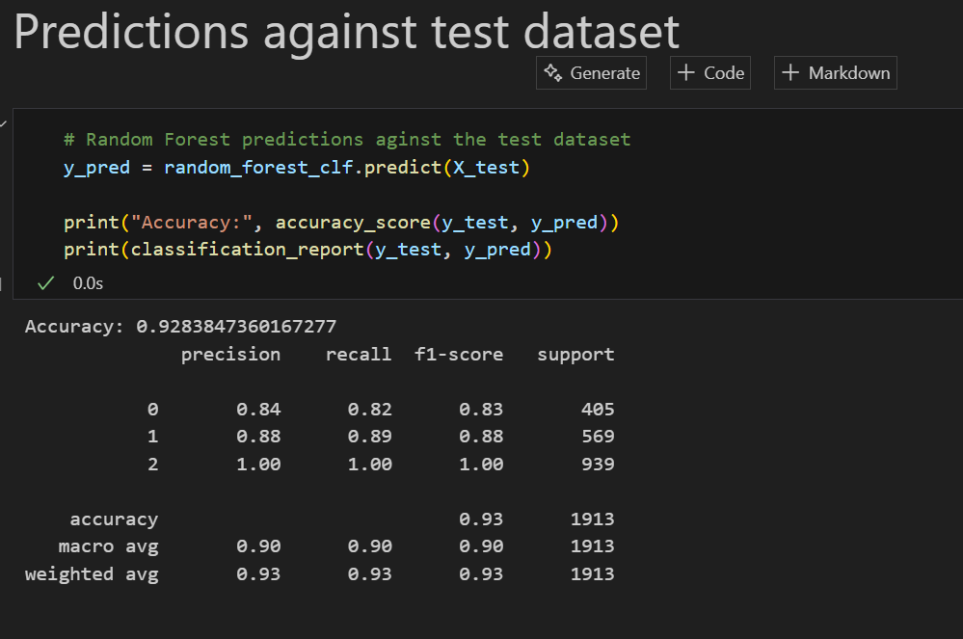

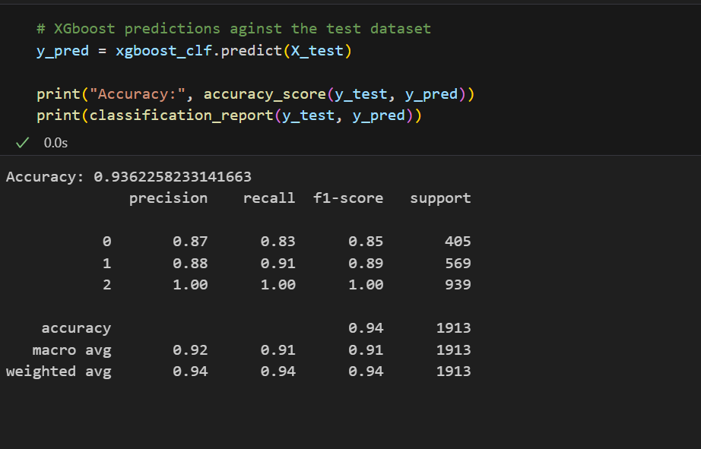
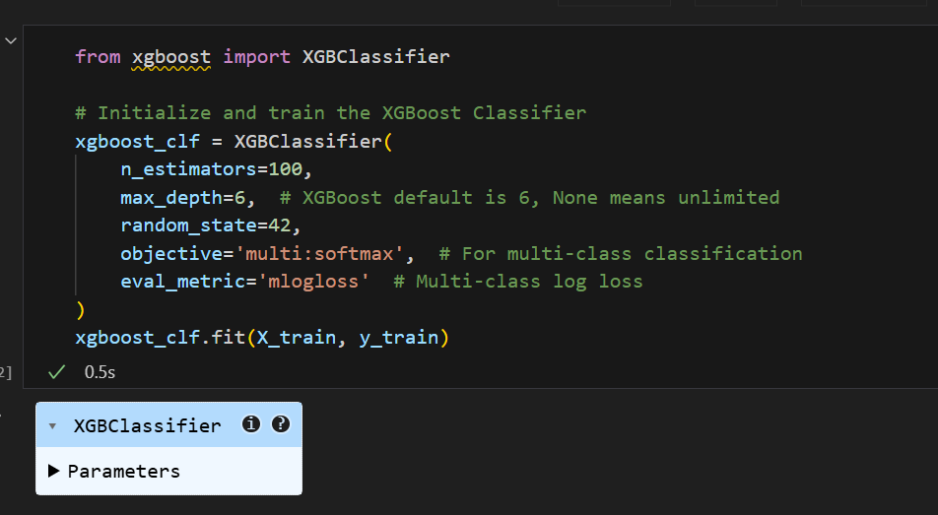
Machine Learning Approach's
Random Forest
Train
Test
XGBoost
Notes:
In our project, we initially implemented both XGBoost and Random Forest algorithms to identify exoplanets. After thorough evaluation, we decided to stick with the Random Forest Classifier due to the nature of our dataset, which is suited for classification tasks in supervised learning.
Random Forest Classifier: Random Forest is an ensemble learning method that constructs multiple decision trees during training and outputs the mode of the classes for classification tasks. This algorithm is particularly effective for our dataset because it handles large datasets with higher dimensionality and provides robustness against overfitting. Additionally, Random Forest offers interpretability and strong performance metrics, making it an ideal choice for our classification problem.
XGBoost: XGBoost, an optimized gradient boosting algorithm, was also considered for its efficiency and performance. However, despite its advantages, we observed that Random Forest provided better results for our specific dataset. XGBoost's complexity and sensitivity to hyperparameters required extensive tuning, which was not feasible given our dataset's characteristics.
Deep Learning Considerations: While deep learning models like neural networks are powerful, they require large amounts of clean, well-distributed data. Our dataset contains outliers and is not compatible with such models. Neural networks are prone to overfitting with smaller datasets and outliers, making them less suitable for our current data.
Performance Metrics: To validate our model, we used several key performance metrics:
Accuracy: Measures the overall correctness of the model by calculating the ratio of correctly predicted instances to the total instances. It is a useful metric when the classes are balanced.
[ \text{Accuracy} = \frac{\text{True Positives} + \text{True Negatives}}{\text{Total Instances}} ]
Precision: Indicates the proportion of true positive predictions among all positive predictions. It is crucial when the cost of false positives is high.
[ \text{Precision} = \frac{\text{True Positives}}{\text{True Positives} + \text{False Positives}} ]
Recall (Sensitivity): Measures the proportion of true positive predictions among all actual positive instances. It is important when the cost of false negatives is high.
[ \text{Recall} = \frac{\text{True Positives}}{\text{True Positives} + \text{False Negatives}} ]
F1 Score: A harmonized mean of precision and recall, providing a single metric that balances both concerns.
[ \text{F1 Score} = 2 \times \frac{\text{Precision} \times \text{Recall}}{\text{Precision} + \text{Recall}} ]
By using these metrics, we ensured that our Random Forest model provided reliable and accurate predictions for exoplanet identification.

Slide 9



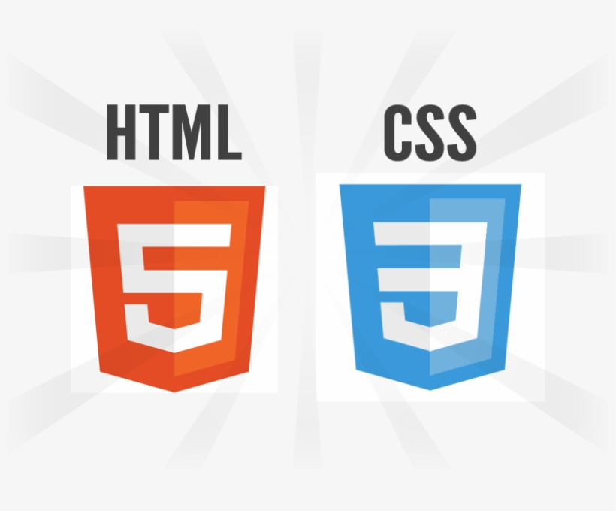
DeepSky Divers
Enhancing your
presentation
DEMO..!!
https://deepskydivers.us
Notes:
We are excited to present our application, which has been hosted on Render. You can access it via the following link: https://deepskydivers.us.
Technologies Used:
Python: Utilized for backend development and implementing machine learning models.
HTML: Structured the content and layout of our web application.
CSS: Styled the web application to ensure a user-friendly interface.
GitHub Pages: Managed version control and collaborated on the project.
Render: Deployed our web application for easy access and scalability.

Slide 10
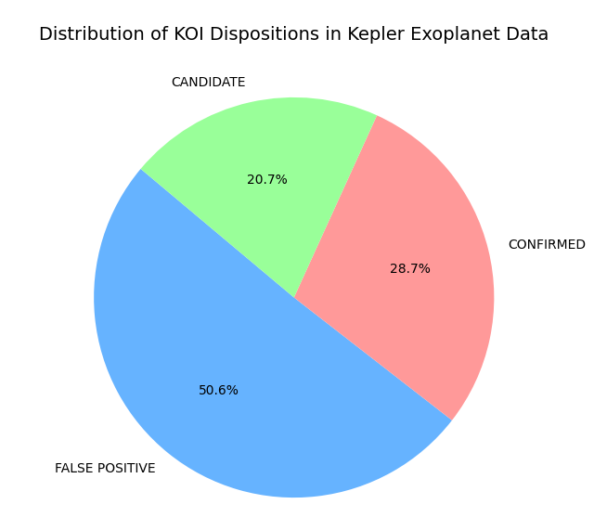
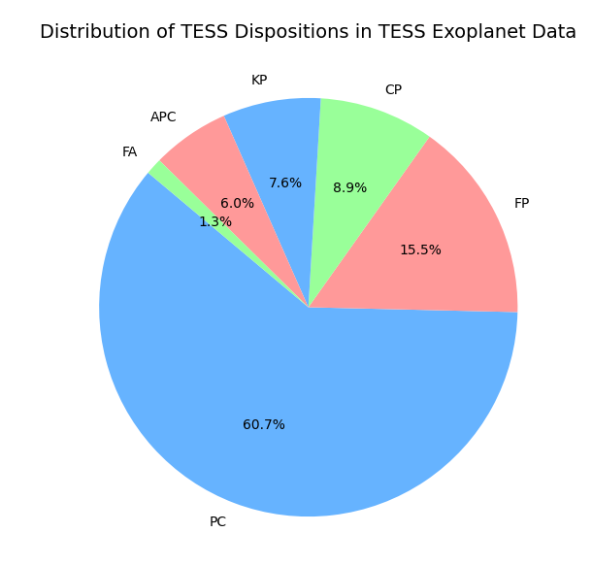
Challenges
Handling Scaling datasets and missing values.
Ensuring consistent preprocessing for training and prediction.
Dealing with imbalanced classes.
Integrating frontend and backend smoothly.
Notes:
Scaling Datasets: One of the primary challenges was managing the large and varied datasets from NASA missions. We needed to ensure that the data was properly scaled to maintain consistency across different features. This required careful selection of scaling techniques, such as RobustScaler, to handle outliers effectively.
Missing Values: Our datasets contained numerous missing values, which could significantly impact model performance. We addressed this by employing imputation techniques, specifically replacing missing values with the median of the respective columns. This approach minimized the distortion of the dataset and maintained its integrity.
Ensuring Consistent Preprocessing for Training and Prediction:
To achieve reliable and accurate predictions, it was crucial to maintain consistent preprocessing steps for both training and prediction phases. This included standardizing the processes of feature selection, scaling, and encoding. Any discrepancies in preprocessing could lead to inconsistencies in model performance, so we implemented rigorous checks and automated pipelines to ensure uniformity.
Dealing with Imbalanced Classes:
Imbalanced classes in our dataset posed a significant challenge, as the number of positive instances (exoplanets) was much lower than the negative instances (non-exoplanets). This imbalance could lead to biased models favoring the majority class. To mitigate this, we employed techniques such as oversampling the minority class, undersampling the majority class, and using class weights in our Random Forest model to ensure balanced learning.
Integrating Frontend and Backend Smoothly:
Integrating the frontend and backend components of our web application required careful coordination and compatibility checks. The backend, developed in Python, needed to seamlessly communicate with the frontend, built using HTML and CSS. Ensuring smooth integration involved setting up APIs, managing data flow, and optimizing performance to provide a responsive and user-friendly experience. Additionally, deploying the application on Render required addressing deployment-specific challenges to ensure stability and scalability.

Slide 11
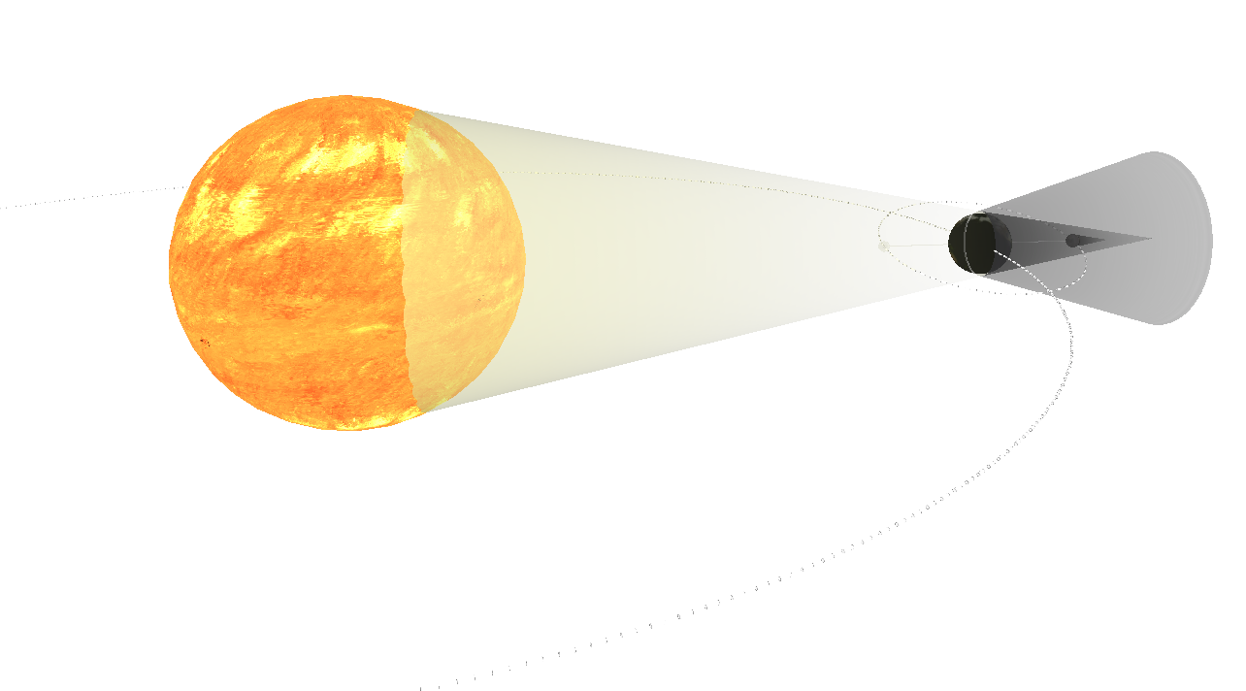
References
NASA Exoplanet Archive datasets
Kepler & TESS mission documentation
Scikit-learn documentation
Pandas' documentation
Relevant research papers and articles
Exoplanet detection using machine learning | Monthly Notices of the Royal Astronomical Society | Oxford Academic
Exoplanet - Wikipedia
Claude Sonnet 3.5
Notes:
NASA Exoplanet Archive datasets: The primary source of our exoplanet data.
Kepler & TESS mission documentation: Essential info on how the data was collected.
Scikit-learn documentation: Our go-to guide for implementing machine learning algorithms.
Pandas' documentation: Helped us with data manipulation and preprocessing.
Relevant research papers and articles: Provided insights and methodologies for our project.
"Exoplanet detection using machine learning" | Monthly Notices of the Royal Astronomical Society | Oxford Academic: A key paper that influenced our approach.
Exoplanet - Wikipedia: A solid starting point for understanding exoplanets.
Claude Sonnet 3.5: Assisted in refining our text and explanations.

Slide 12

Future Goals:
Integrate more advanced ML models (e.g., deep learning).
Implement AI Agent.
Add support for more datasets (e.g., K2).
Improve UI/UX for broader accessibility.
Notes:
Integrate More Advanced ML Models (e.g., Deep Learning):
We aim to incorporate more sophisticated machine learning models, such as deep learning techniques, to enhance the accuracy and robustness of our exoplanet detection. By leveraging neural networks, we hope to better handle complex patterns and relationships within the data, improving our predictive capabilities.
Implement AI Agent:
Developing an AI agent to automate various aspects of data analysis and prediction is a key goal. This agent will assist in real-time processing, continuous learning, and adaptive decision-making, making our system more efficient and responsive to new data.
Add Support for More Datasets (e.g., K2):
Expanding our dataset support to include additional sources like the K2 mission will provide a richer and more diverse pool of data. This will enable us to refine our models further and explore a wider range of exoplanet characteristics, leading to more comprehensive analyses.
Improve UI/UX for Broader Accessibility:
Enhancing the user interface and user experience of our web application is crucial for making it accessible to a broader audience. We plan to implement more intuitive navigation, clearer visualizations, and user-friendly features to ensure that both scientists and enthusiasts can easily interact with and benefit from our application.

Slide 13

Thank you
Reach out to us..
Any Questions..
sanjana.vishwanatha2000@gmail.com
nagarjunts008@gmail.com
Notes:
Thank you for your attention! We are open to any questions you may have.
Effort and Experience: We put a tremendous amount of effort into this project, dedicating countless hours to data analysis, model development, and application design. It was a challenging yet incredibly rewarding experience. We are thrilled to have been part of the NASA Space Apps Challenge, and it has been an honor to contribute to such an exciting and impactful initiative.

